Slide 1

C language
Bean Eating!
------Project of:
Sun Haoran Yang Lixinhao
Shen Yucheng Yu yue

Slide 2

01
02
03
Analyze &
Implementation
Division of labor
Introduction

Slide 3
01
Introduction
Notes:
OK, let’s see the introduction part.

Slide 4
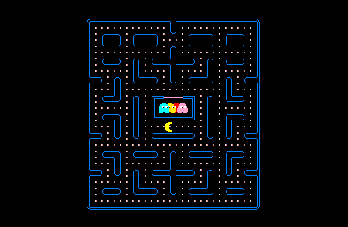
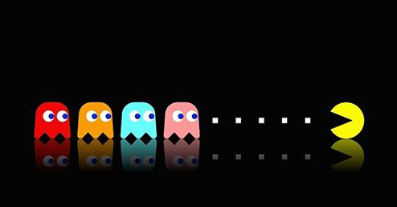

Introduction
How to play
The goal of the game is to accumulate points by eating all the Dots in the maze and the four ghosts roam the maze, trying to kill Pac-Man.
History
Pac-Man is an arcade game developed by Namco and first released in Japan in May 1980.
Notes:
Considered one of the most classical even the symbol of 1980s popular culture.
Try your best to complete this level and start the next level.

Slide 5
02
Analyze &
Implementation

Slide 6
Analyze
START
Main
Function
Player:
structure
Ghosts
structure
The speed
of ghost
Define Section
Dot per second
Life=3
The position
of player
The position
of ghost
dot (x, y)
Name 1
Name 2
Name 3
Name 4
Map
Design
The direction
of ghost
The direction
of player
UP: y++
DOWN: y--
Position=
(x₀,y₀)
Position 1=
(x₁,y₁)
Position 2=
(x₂,y₂)
Position 3=
(x₃,y₃)
Position 4=
(x₄,y₄)
Control Function
LEFT: x--
RIGHT: x++
Size
Size
Size
Size
Size
Level
i=1;i++
(3 levels)
Decide
Function
Decide Function
END
Notes:
give a loop
initialized all of the settings, get in the loop,
loop will be back
Initialization part. VGA screens, coordinate of the screen

Slide 7
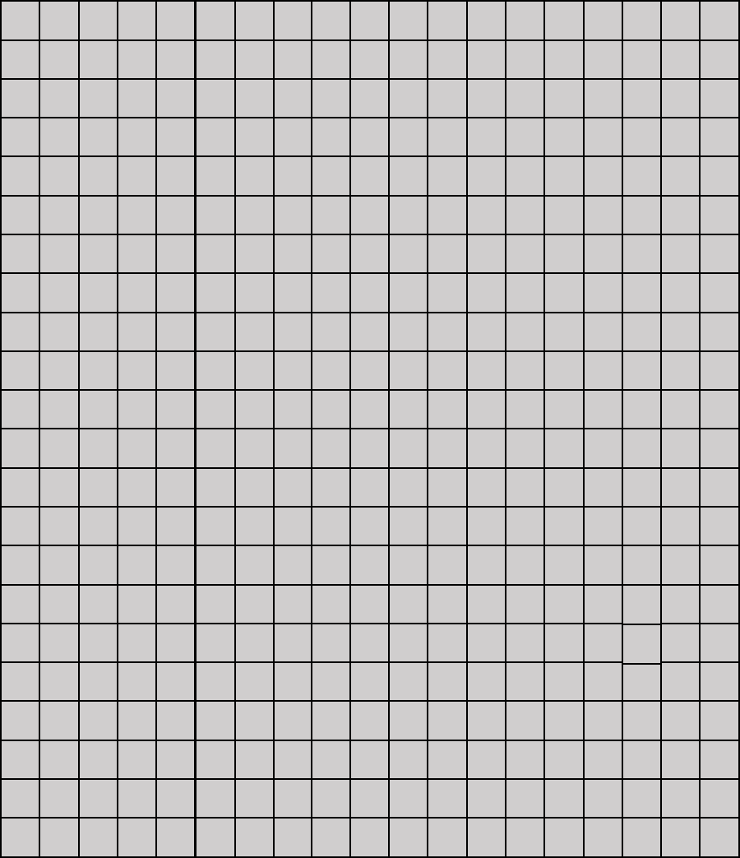
Analyze
Empty Map
20*20 dots
23*19 lattices
total:
440*380 dots
road：black
wall：white
Map
design
Notes:
“position” of the map lattices

Slide 8
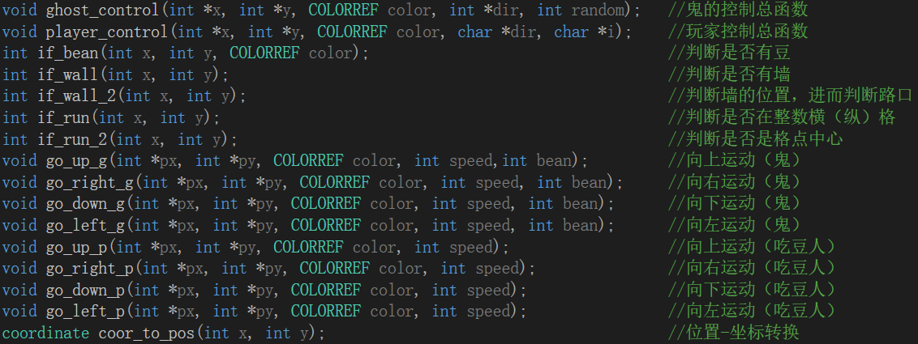
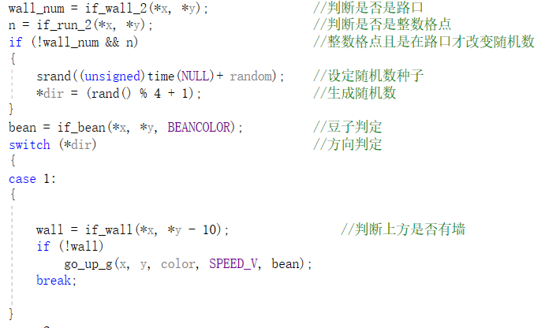
Analyze
Ghost control
The movement
of ghosts
Random
1,2,3,4
Switch:
Control
function
1
2
3
4
Wall
UP ?
Wall
LEFT ?
Wall
DOWN ?
Wall
RIGHT?
N
Y
N
Y
N
Y
N
Y
Change direction to
UP
Change direction to
LEFT
Change direction to
DOWN
Change direction to
RIGHT
Do Not Change The Direction
Notes:
The most complex part,10 functions
Random numbers to command the ghost,

Slide 9
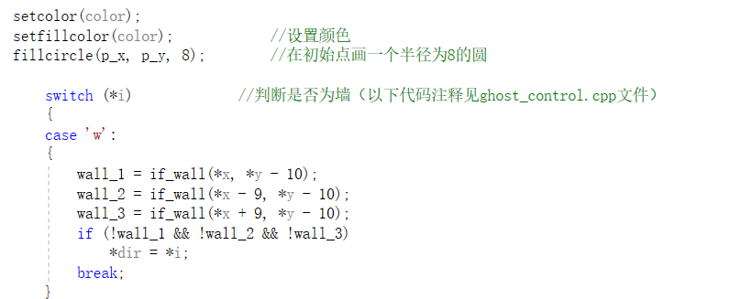
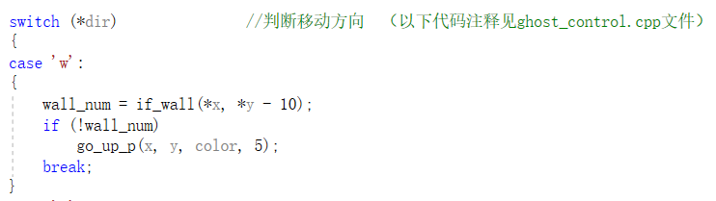
Analyze
Player control
The movement
of player
Read:
W,A,S,D
Switch:
W
A
S
D
Wall
UP ?
Wall
LEFT ?
Wall
DOWN?
Wall
RIGHT?
N
Y
N
Y
N
Y
N
Y
Change direction to
UP
Change direction to
LEFT
Change direction to
DOWN
Change direction to
RIGHT
Do Not Change The Direction
Notes:
Wasd control to command the Pac-Man
some functions to know if there is a wall

Slide 10
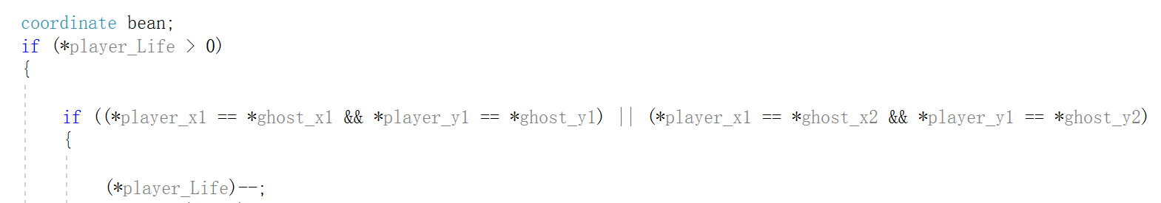
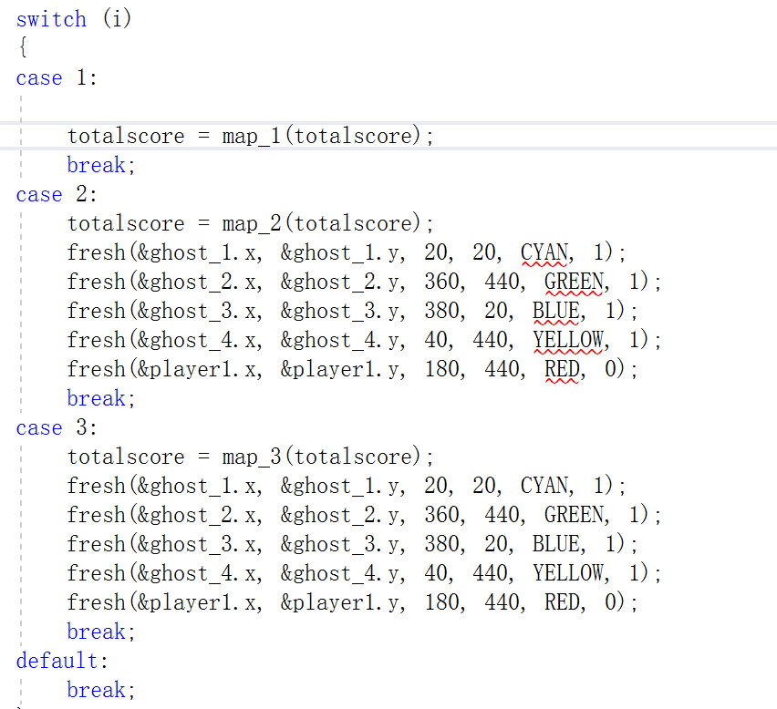
Analyze
Read:
the position of player;(x,y)
Eat a bean plus 10 scores
Read:
the position of ghosts;(x_{i},y_{i})
Player’s scores== scores of this level
(x,y)==
(x_{i},y_{i})
Life-1
Next level
Life==0
Game
Over
You win
Y
N
Continue
Notes:
After changing, read the new coordinate
refresh the position check the life number
check if you score is enough
That all the main algorithm. Let’s invite yy to give the solution on,,,,,, with codes in details

Slide 11
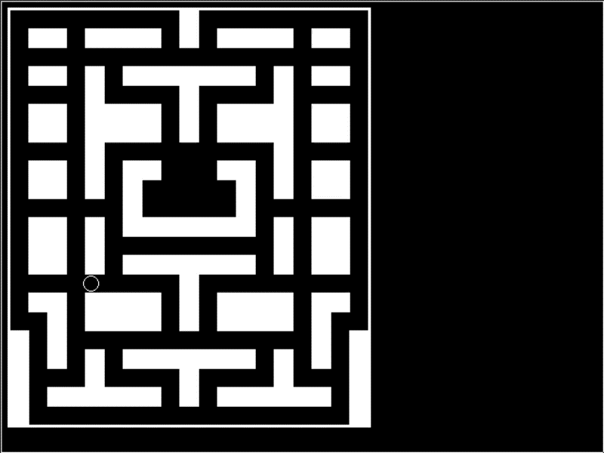
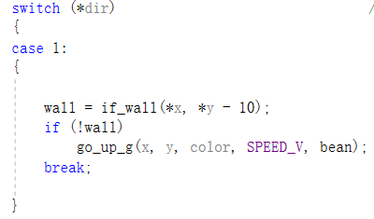
Function implementation & Test
Reason: The ghost moves by wiping off the previous image and drawing a new one. If it can’t judge whether the four directions are a wall or not, the movement of the ghost will cause the wall to be eaten.
Ghost eating wall
Judging whether there is a wall above
If (x, y-10) is white?
N
Still move
Y
Break
Notes:
OK, now let’s see some problems in detail. The first question we met-why

Slide 12
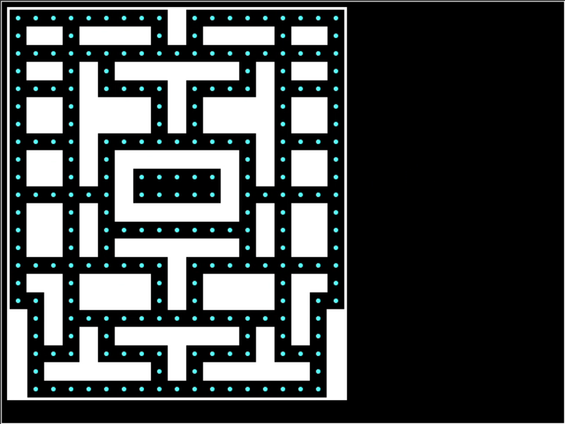
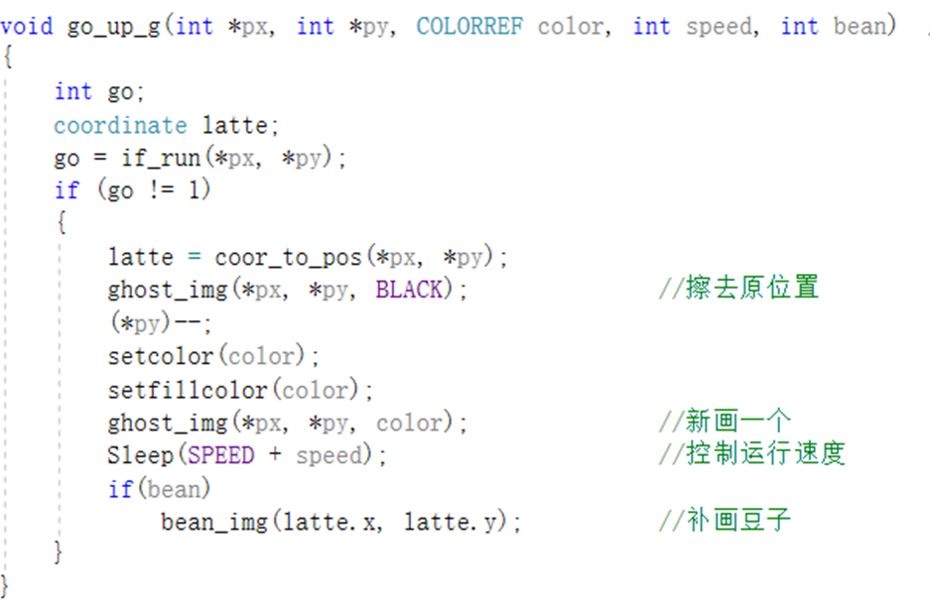
Function implementation & Test
Reason: The ghost moves by wiping off the previous image and drawing a new one. At first we decided to draw a black ghost in the previous position, but we do not draw the bean.
Ghost eating bean
Get the coordinate of the ghost
1
Color==
BEAN
CENTER
Change the coordinate to the position
N
Y
Move
Move
Check the color of the position
Draw the bean again at the same position
1
Notes:
This problem is quite similar to the former one.

Slide 13
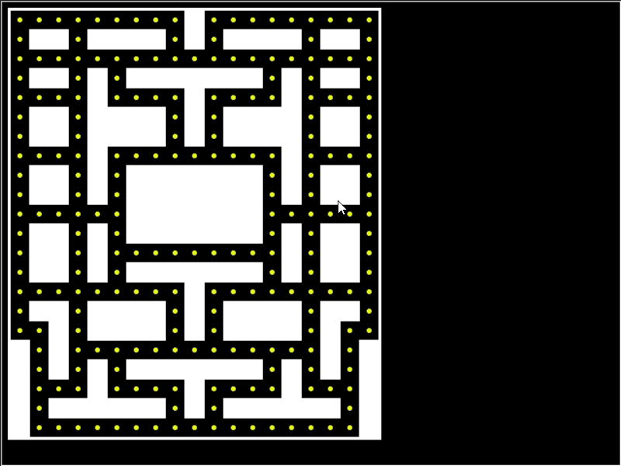
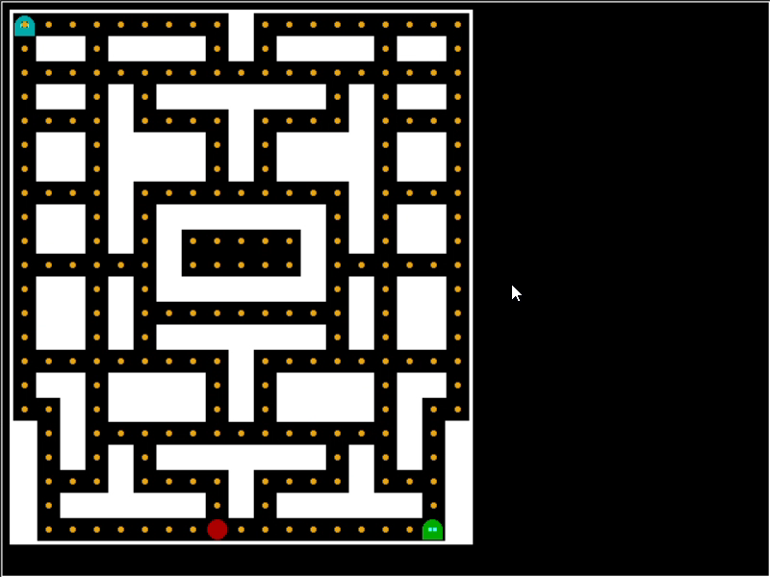
Function implementation & Test
Reason: In the beginning, our design was to press w a s d to control the direction of movement. If there is no new command , it will move in the previous direction. But we have a moving judgement that if the pac_man’s coordinate is not an integer multiple of 20, the pac_man will not move in the command direction, but the previous command has been overwritten, so the pac_man will be stationary.
Movement of Pac_man
The old command
Input a new command
Is the command valid?
Executing this new command
Y
N
Executing the old command
Notes:
How solve? When we make movement judgement, if it’s invalid, we will ignore it and save it then we can try it again.
It’s a loop and the command will be executed until it’s valid.

Slide 14
03
Division of labor

Slide 15
Division of labor
Sun Haoran
Yang Lixinhao
Shen Yucheng
Yu Yue
1.Give the main idea of the general algorithm.
2.Do the main control function.
3.Check the code and algorithm finally, and fix some of the bugs.
4.Design and creating the moving function
5.Do the research from the internet, and communicate with other groups.
1.Advance the control function.
2.Give the algorithm and the code of initialize.
3.Make the PPT of every presentation.
1.Give the algorithm of changing the level.
2.Make the final PPT.
1.Design the maps.
2.Give the algorithm about the judgement on if you win.

Slide 16

C language
THANK YOU!
END
Notes:
As a group, we actually get a lot during this project. Not only on C languages, and also in the teamwork. The game maybe not very perfect, but we really do a lot to perfect it.

